Slide 1
PRISM
Daniel Hellfeld

Slide 2
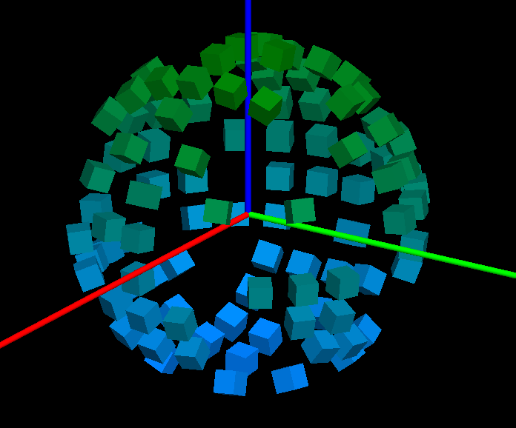
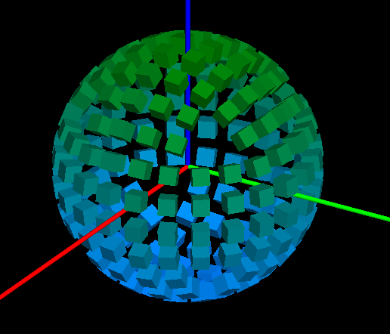
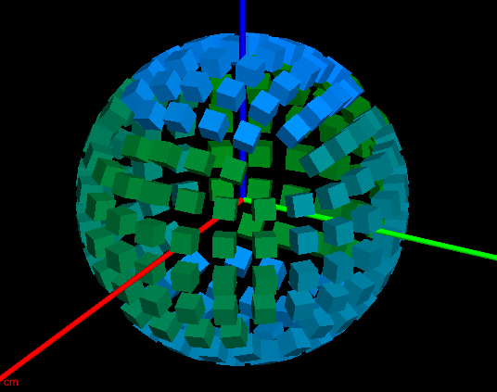
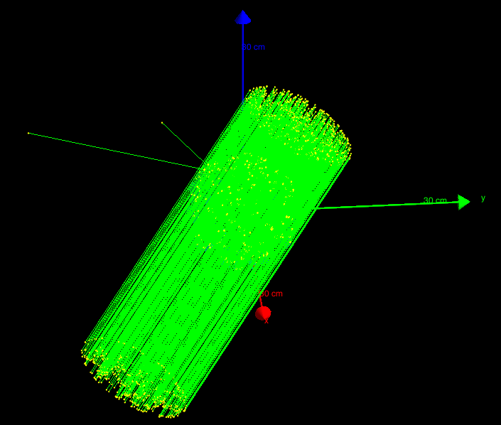
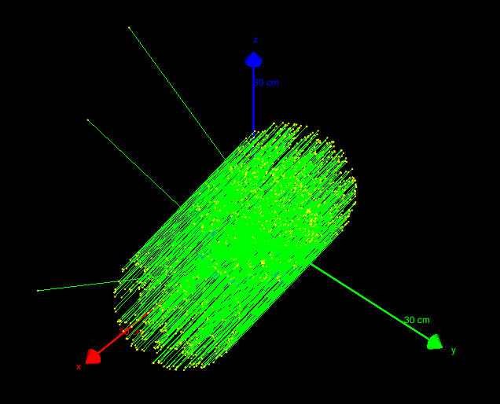
Geant4 simulation – PRISM_SIM
(https://github.com/dhellfeld/CAI_Toy_Imager)
Random mask – ringed detectors
Fully populated – ringed detectors
Fully populated – nested detectors
Running particles

Slide 3
# Run.mac
# Tracking secondary electrons
#/PRISM_SIM/tracking/trackElectrons Off
# Detector indexing
/PRISM_SIM/geom/detIndexing Ring
# Configure mask
#/PRISM_SIM/geom/setMask 21524FA478BD521AB44791322B545C979943A029753854BB
#/PRISM_SIM/geom/randomMask
/PRISM_SIM/geom/fullMask
# Change the energy
/gun/energy 60 keV
# Set the direction of far field source
#/PRISM_SIM/direction/setTheta 45
#/PRISM_SIM/direction/setPhi 20
# Configure HEALPix
/PRISM_SIM/direction/setHPNside 8
/PRISM_SIM/direction/setHPindexscheme Ring
/PRISM_SIM/direction/SetUpHEALPix
# Choose a HealPix angle (start at 1)
/PRISM_SIM/direction/setHPindex 45
# Change output file name
/PRISM_SIM/output/filename output1
#Print to text or binary format
/PRISM_SIM/output/printText Off
/PRISM_SIM/output/printBinary On
# Beam on
/run/beamOn 100
# Response.mac
#/control/loop macros/response/healpix/main.mac hpindex 1 768 1.
/control/loop macros/response/healpix/main.mac hpindex 1 3072 1.
# Main.mac
# Pick healpix angle
/PRISM_SIM/direction/setHPindex {hpindex}

Slide 4
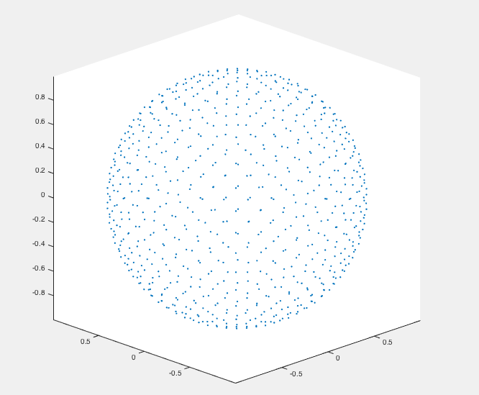
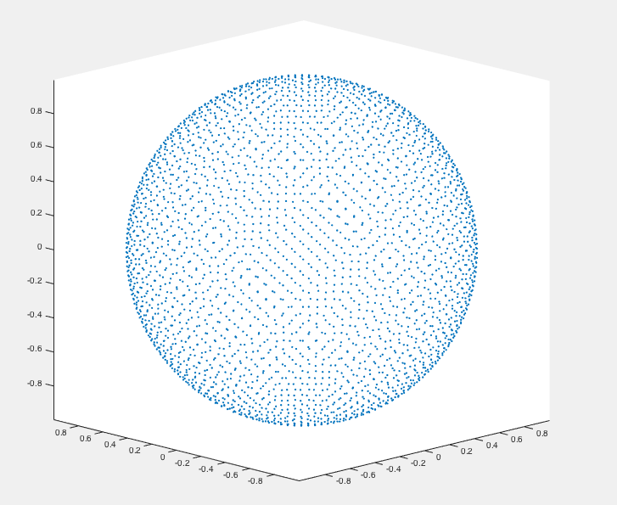
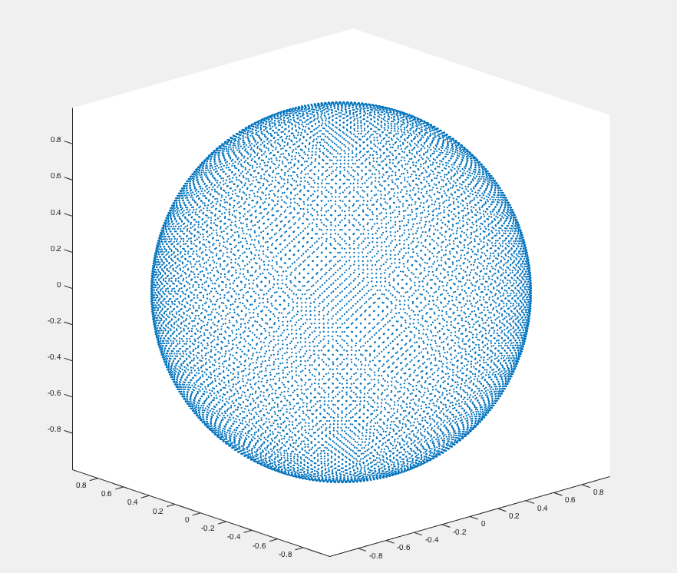
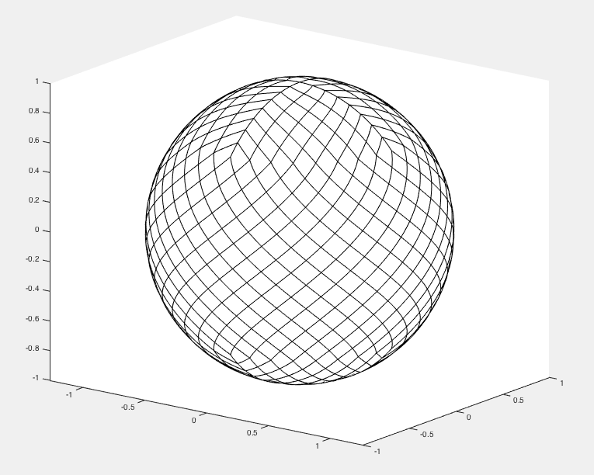
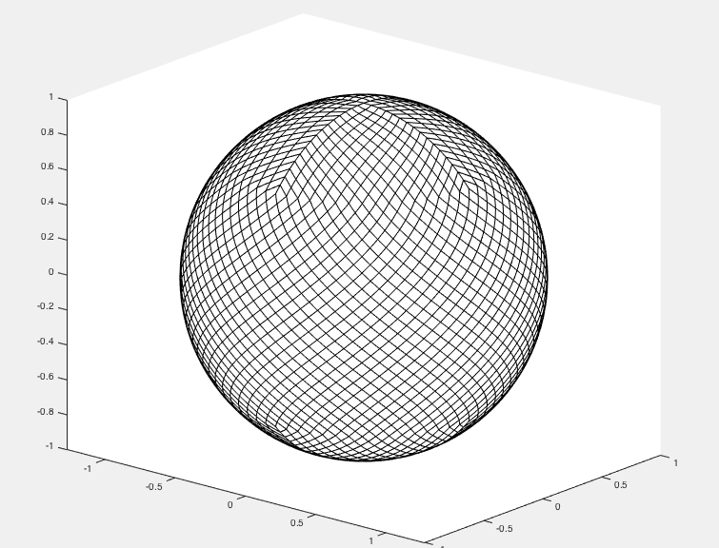
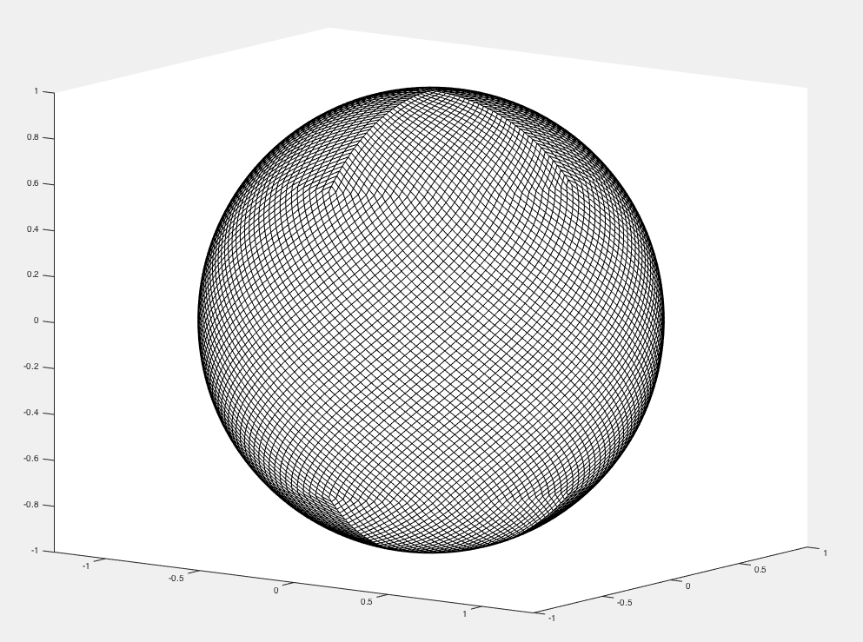
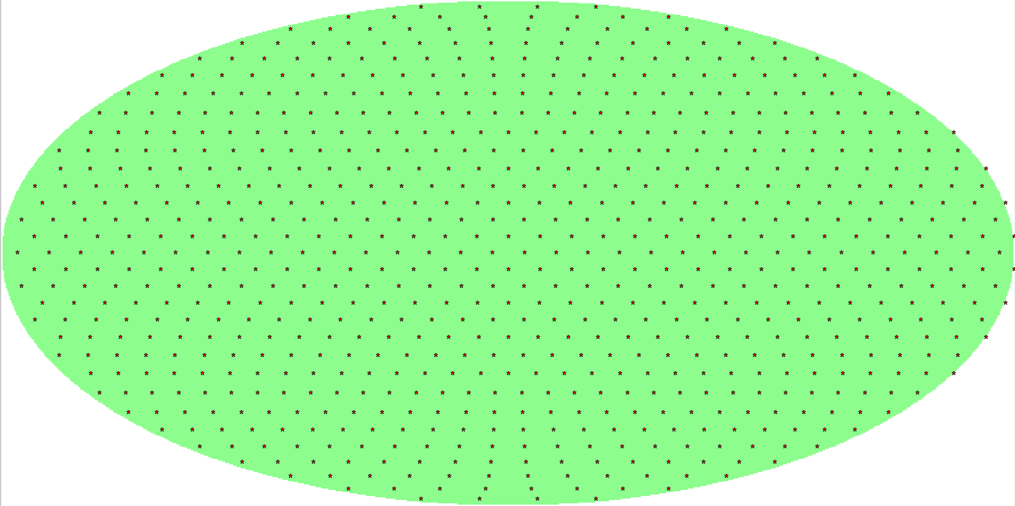
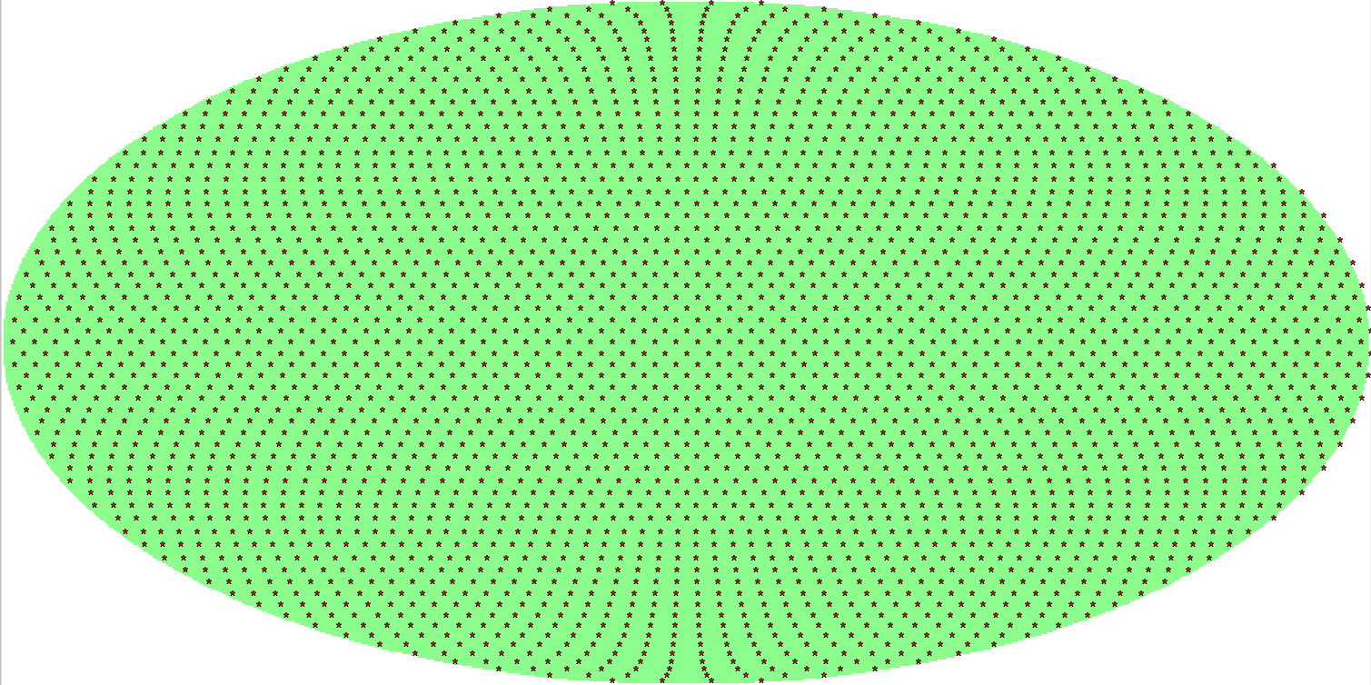
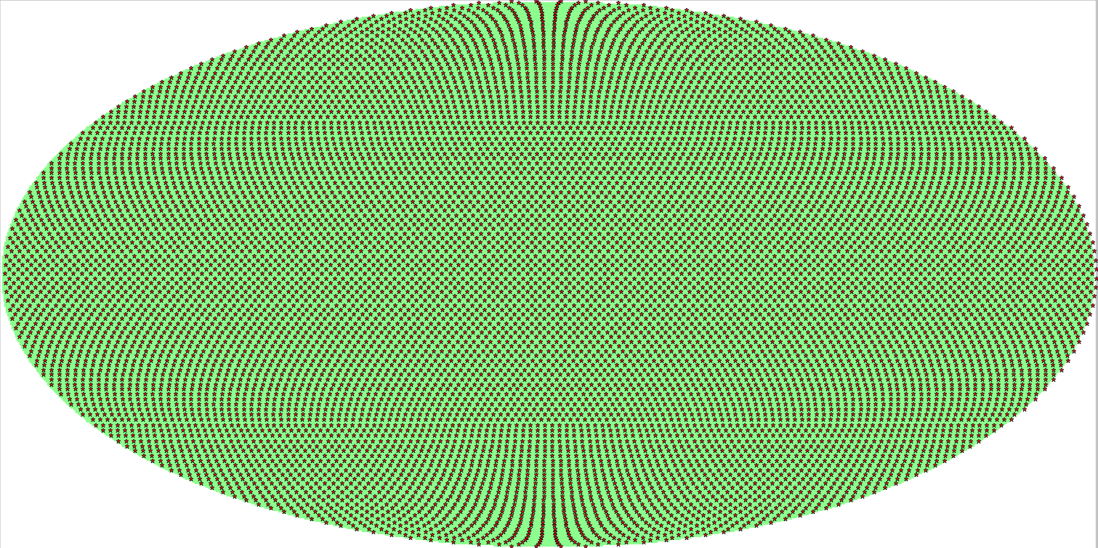
HEALPix – Hierarchical Equal Area isoLatitude Pixelization of a sphere
(Nested or ring … everything done in ring indexing)
Matlab (http://homepage2.nifty.com/plasma/program/healpix.html)
Nside = 8 (768 pixels)
Nside = 16 (3072 pixels)
Nside = 32 (12288 pixels)
Resolution = 7.3 deg
Resolution = 3.7 deg
Resolution = 1.8 deg
Python (healpy) (http://healpy.readthedocs.io/en/latest/index.html)
Nside = 8 (768 pixels)
Nside = 16 (3072 pixels)
Nside = 32 (12288 pixels)

Slide 5
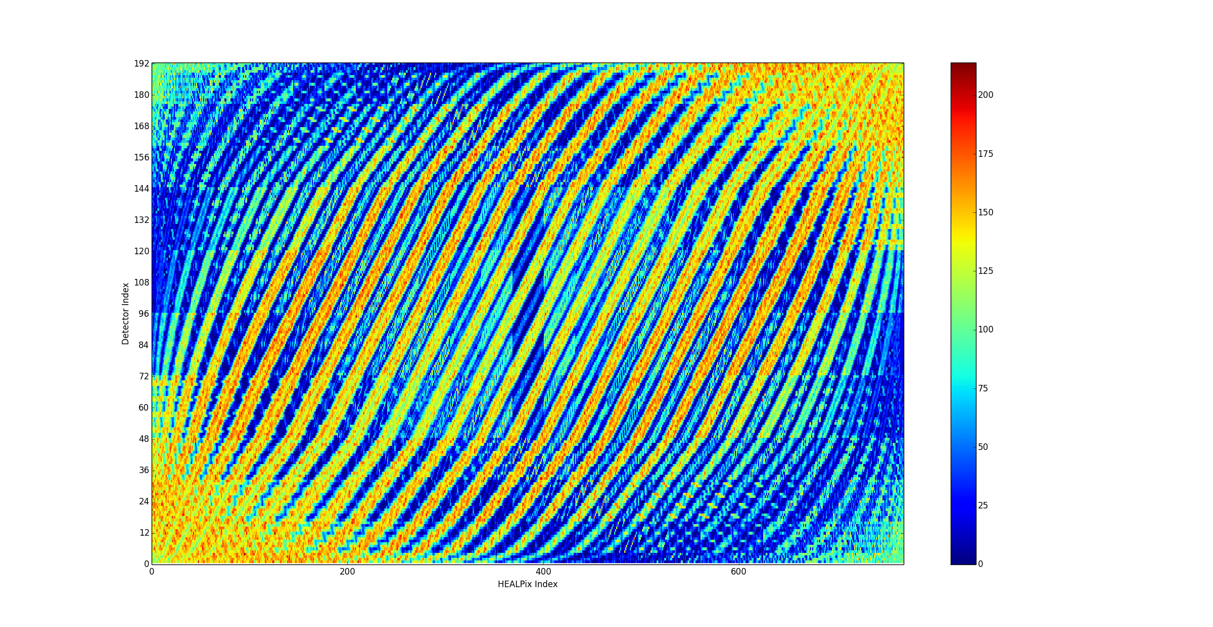
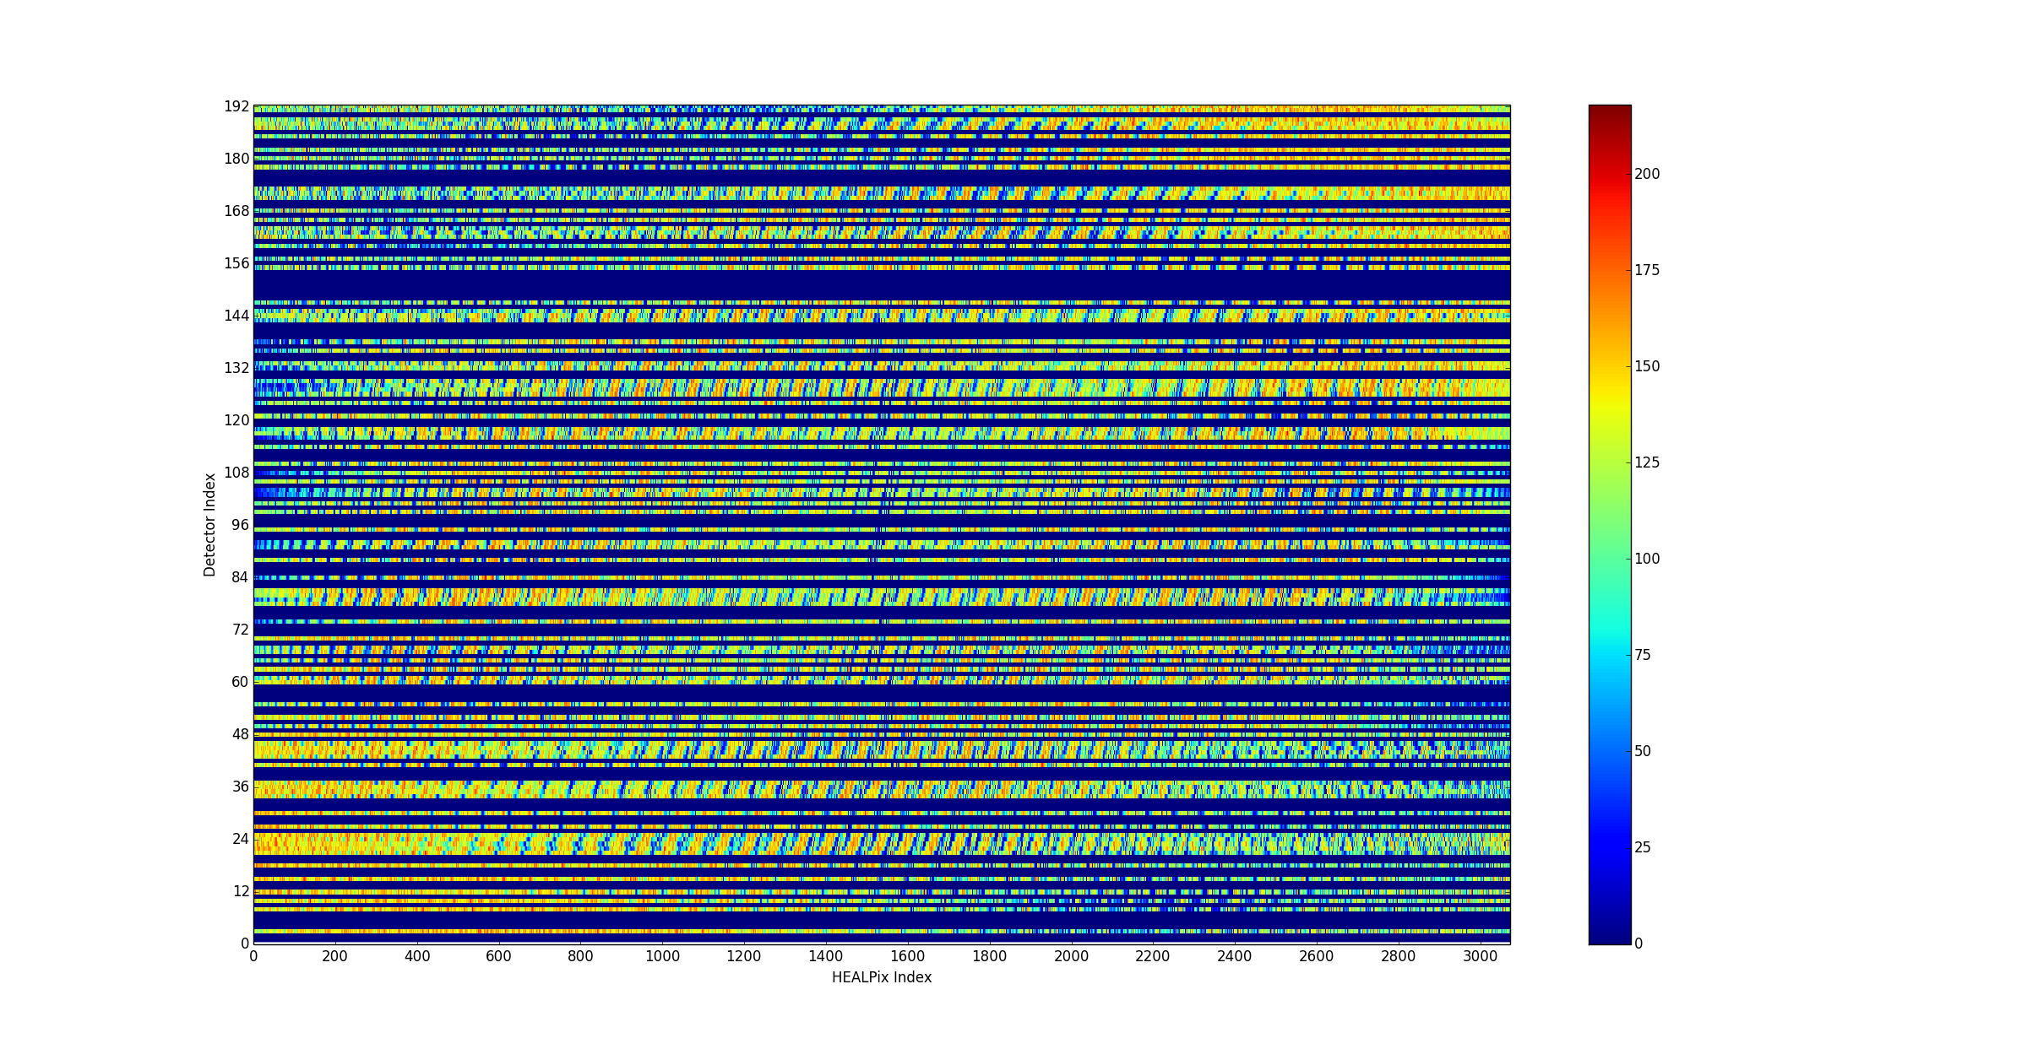
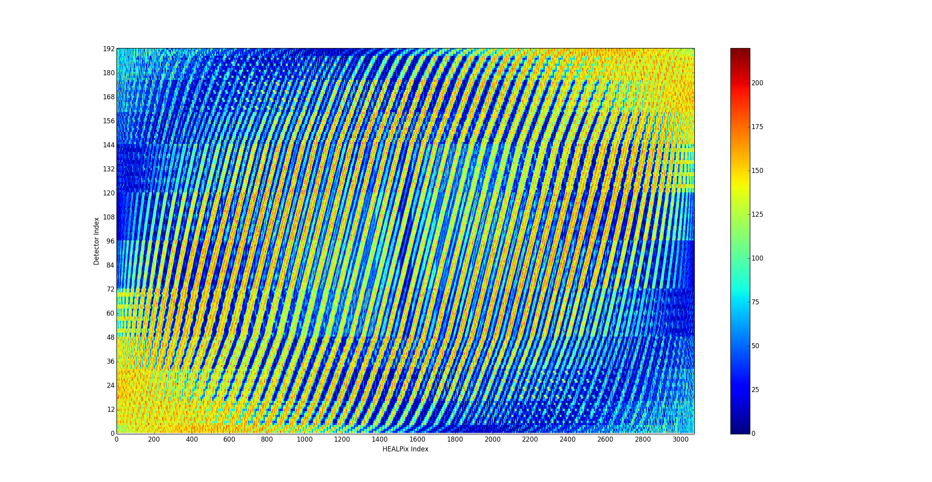
HP ringed, Nside = 8, Ringed detectors, 20k particles, mask = full
HP ringed, Nside = 16, Ringed detectors, 20k particles, mask = 2151…
HP ringed, Nside = 16, Ringed detectors, 20k particles, mask = full

Slide 6
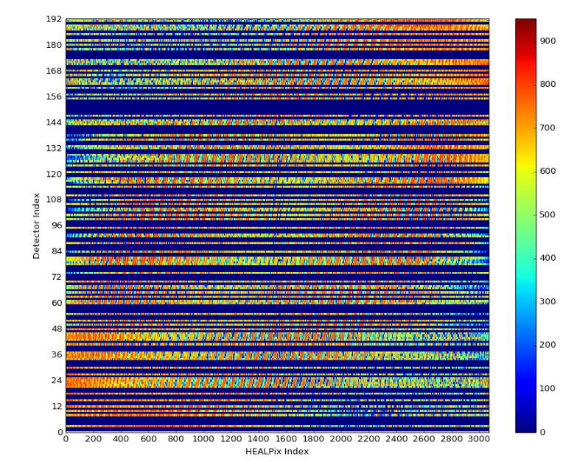
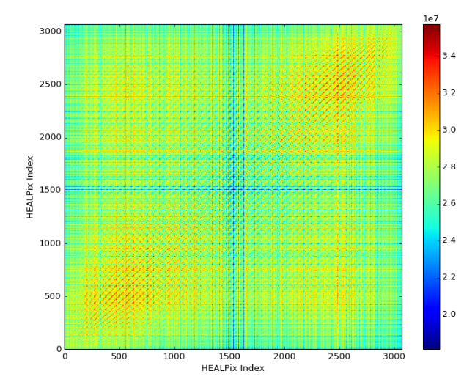
System response = S
S^{T}S (~autocorrelation)
Detector ID vs. Incident HP index
HP ringed, Nside = 16, Ringed detectors
100k particles, mask = 2152…

Slide 7
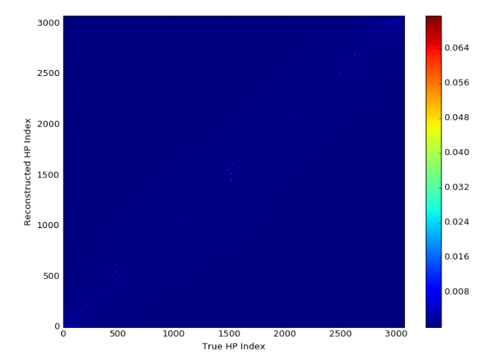
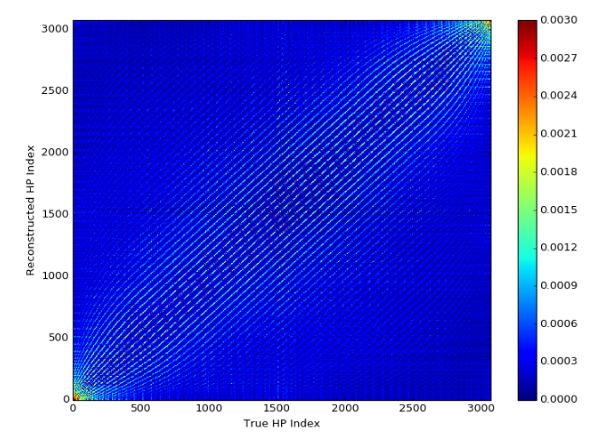
MLEM reconstruction at every source angle
Bring down color map

Slide 8
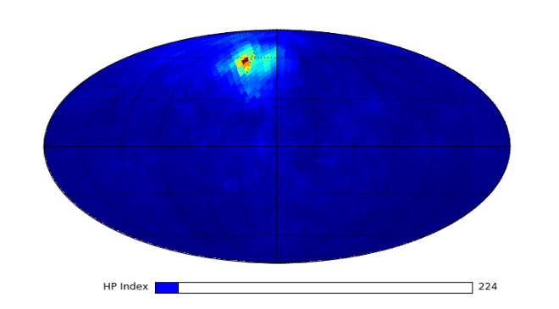
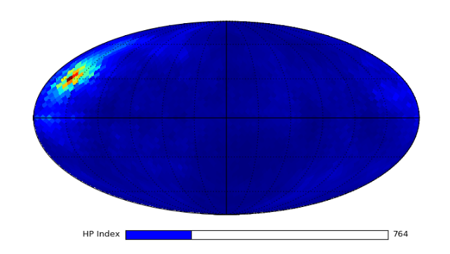
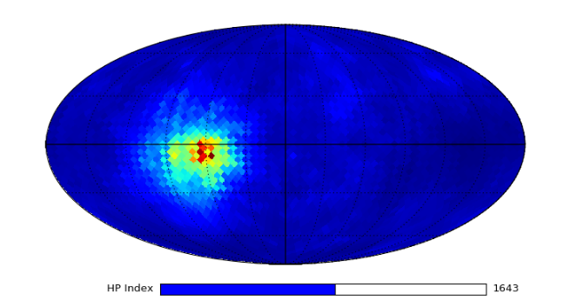
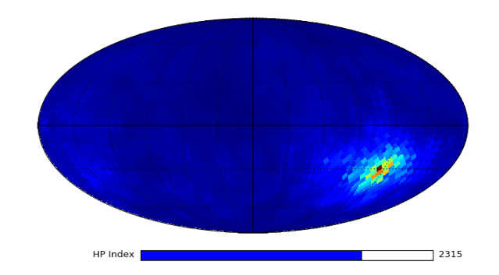
MLEM reconstruction on 4pi sphere with interactive slider

Slide 9
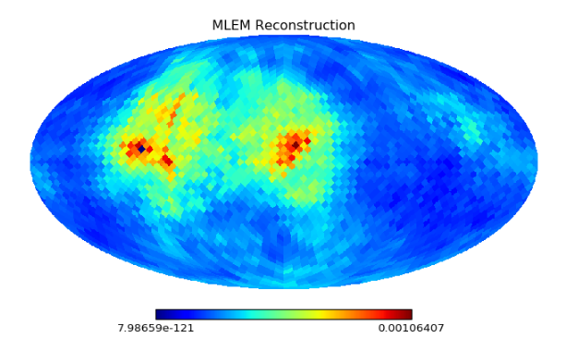
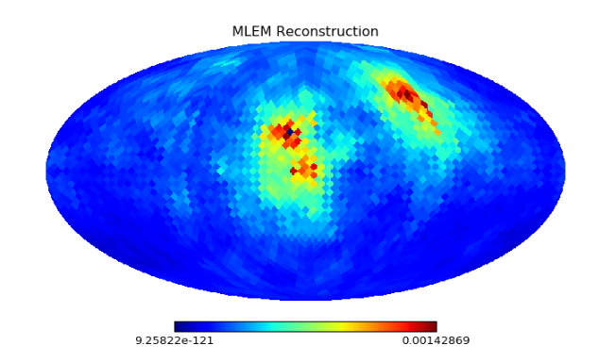
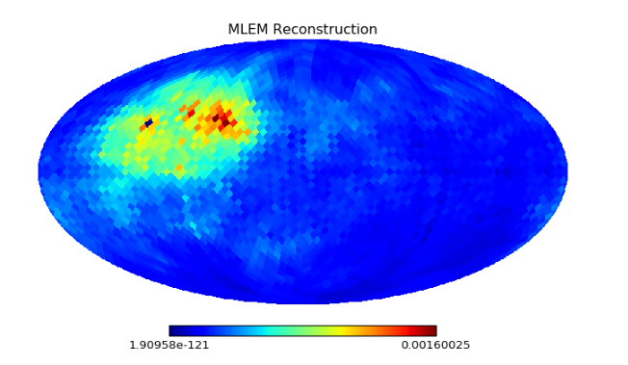
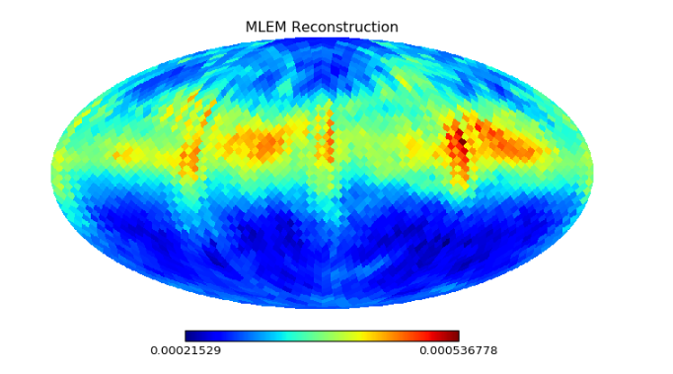
Two sources, ring source
(now put a white cross on true location…)
HP = 1330, 1310
HP = 930, 530
HP = 820, 810
HP = 1248:1312 (ring)

Slide 10
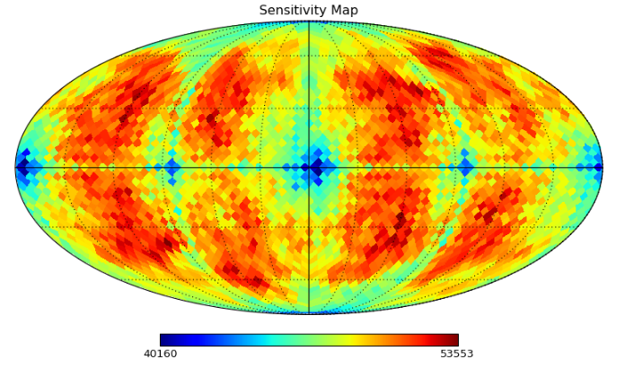
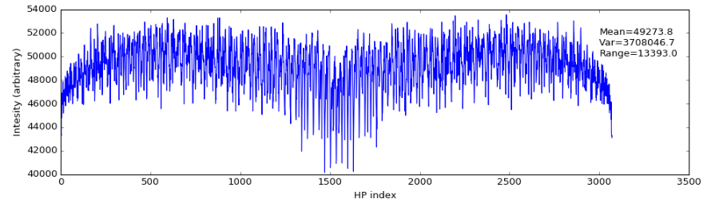
Notice range

Slide 11
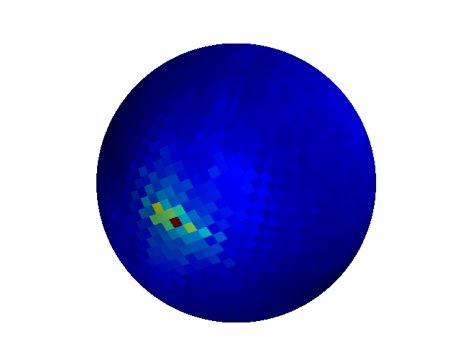
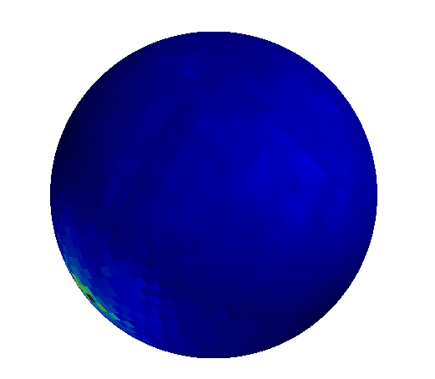
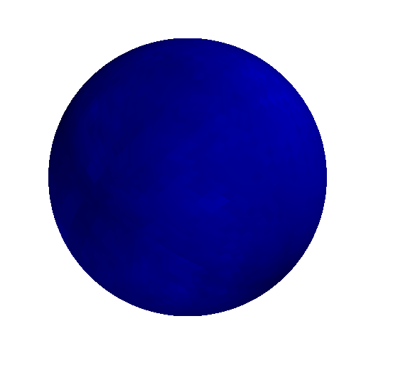
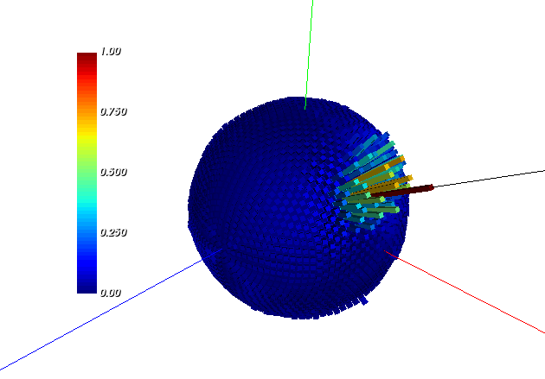
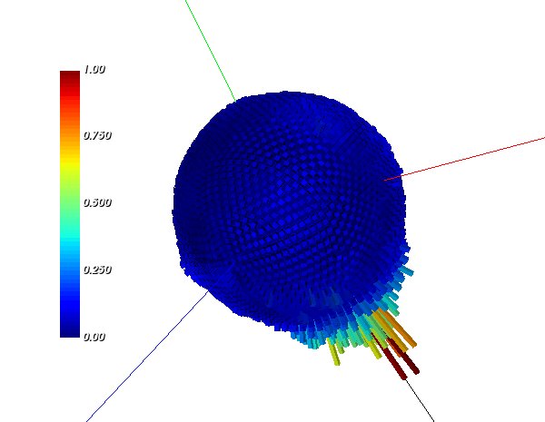
MLEM reconstructed image on 3D sphere (mayavi python)
(heat map)
Spherical histograms (VTK python)
- As opposed to heat map

Slide 12
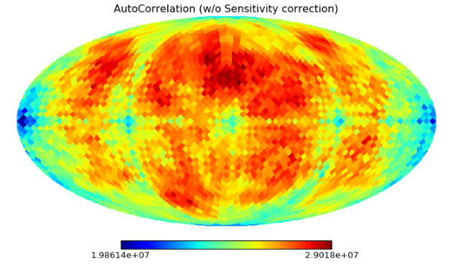
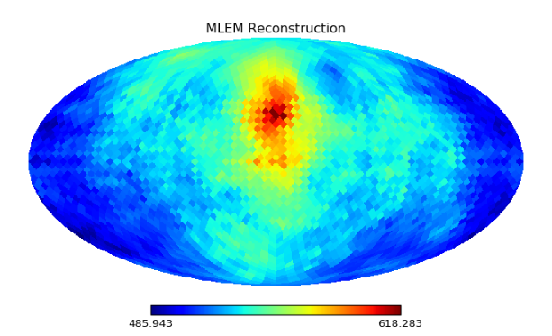
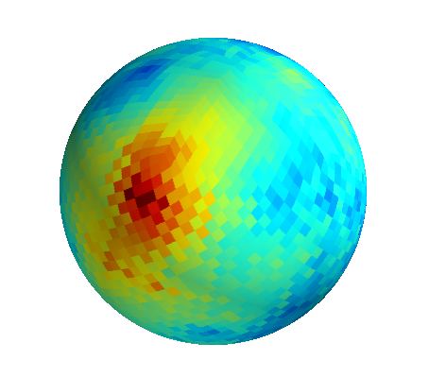
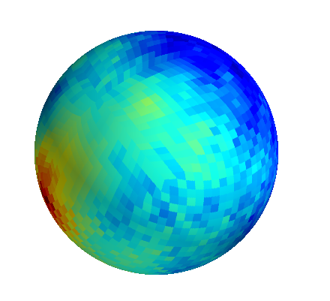
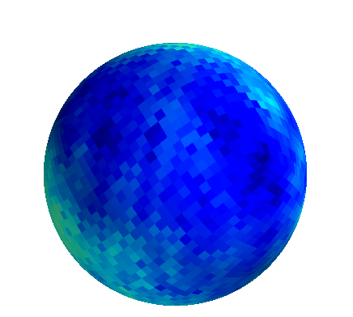
Autocorrelation image, not corrected for sensitivity map
HP index = 800
Row of autocorrelation, corrected for sensitivity map

Slide 13
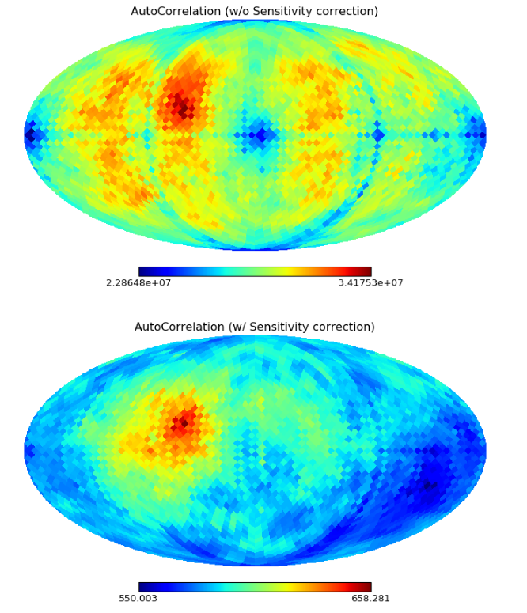
HP index = 1066

Slide 14
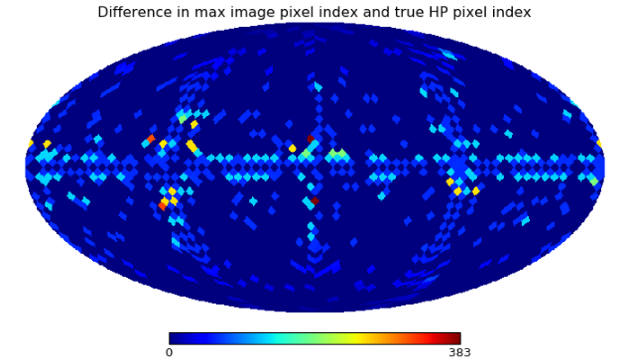
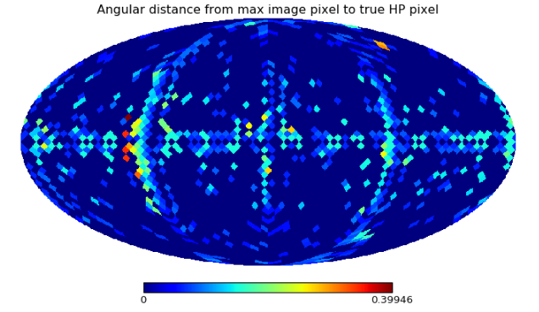
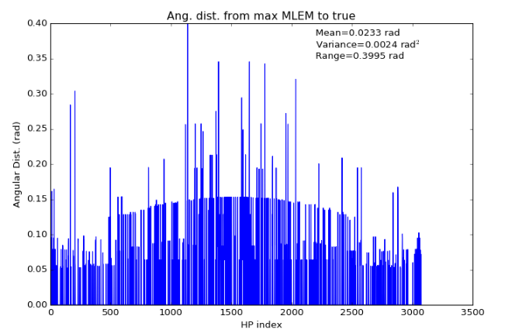
Distance between the peak image pixel index and the true source pixel index for all MLEM reconstructions (not good because it can blow up for images off by a ring)
Angular distance (rad) between the peak image pixel and the true source pixel for all MLEM reconstructions . Gives us a sense of accuracy.

Slide 15
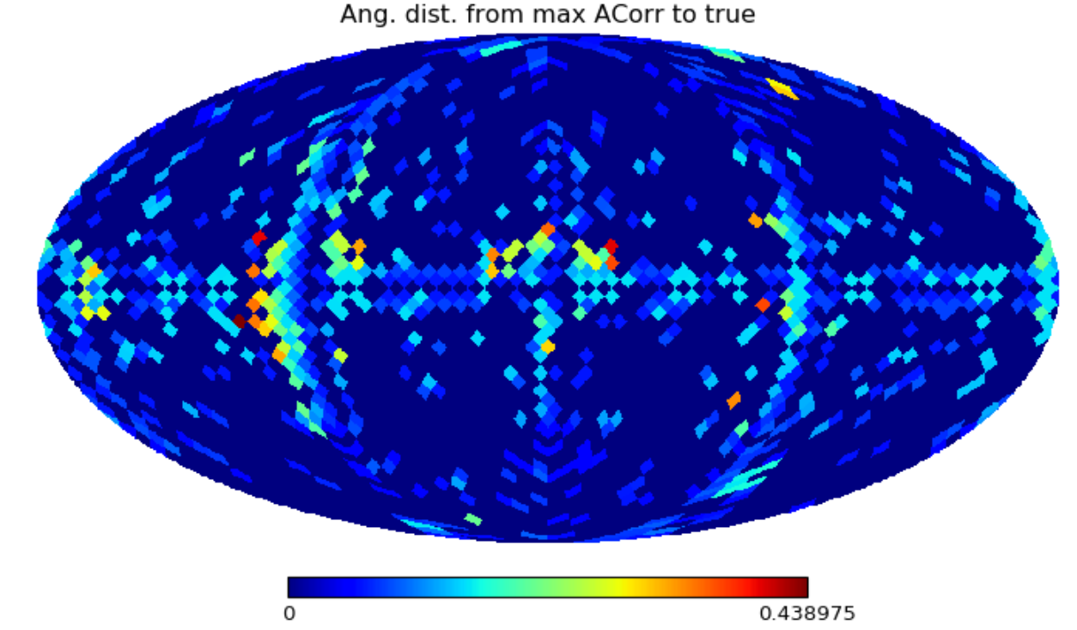
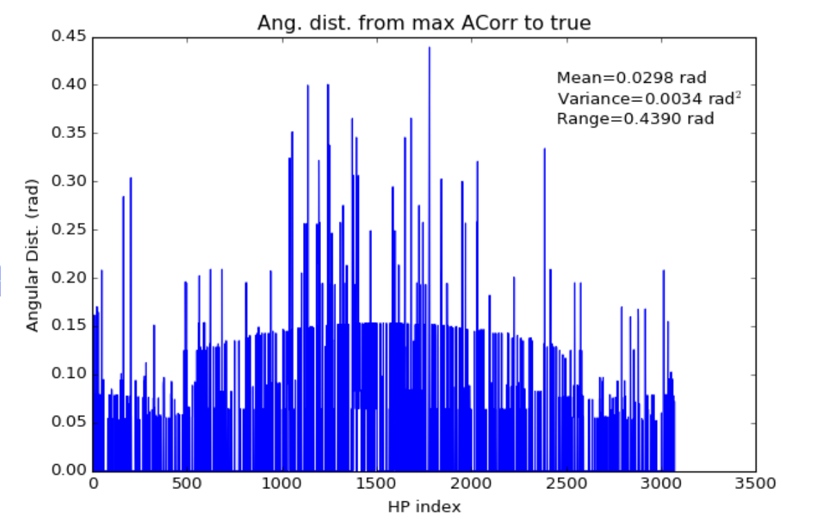
Using the autocorrelation instead of the MLEM image

Slide 16
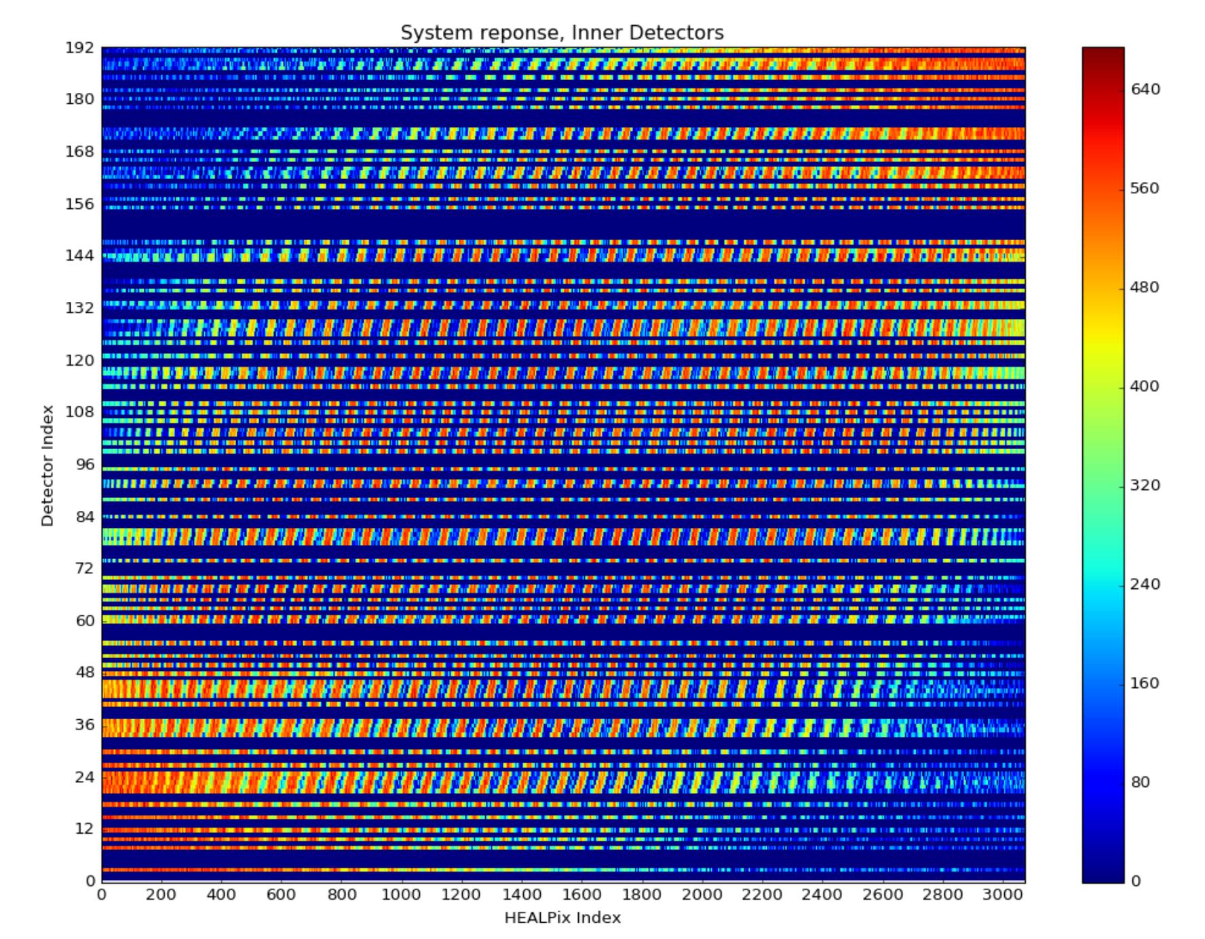
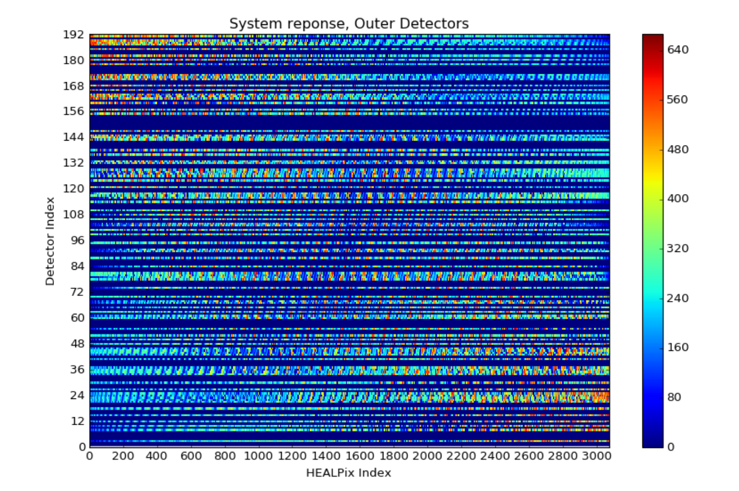
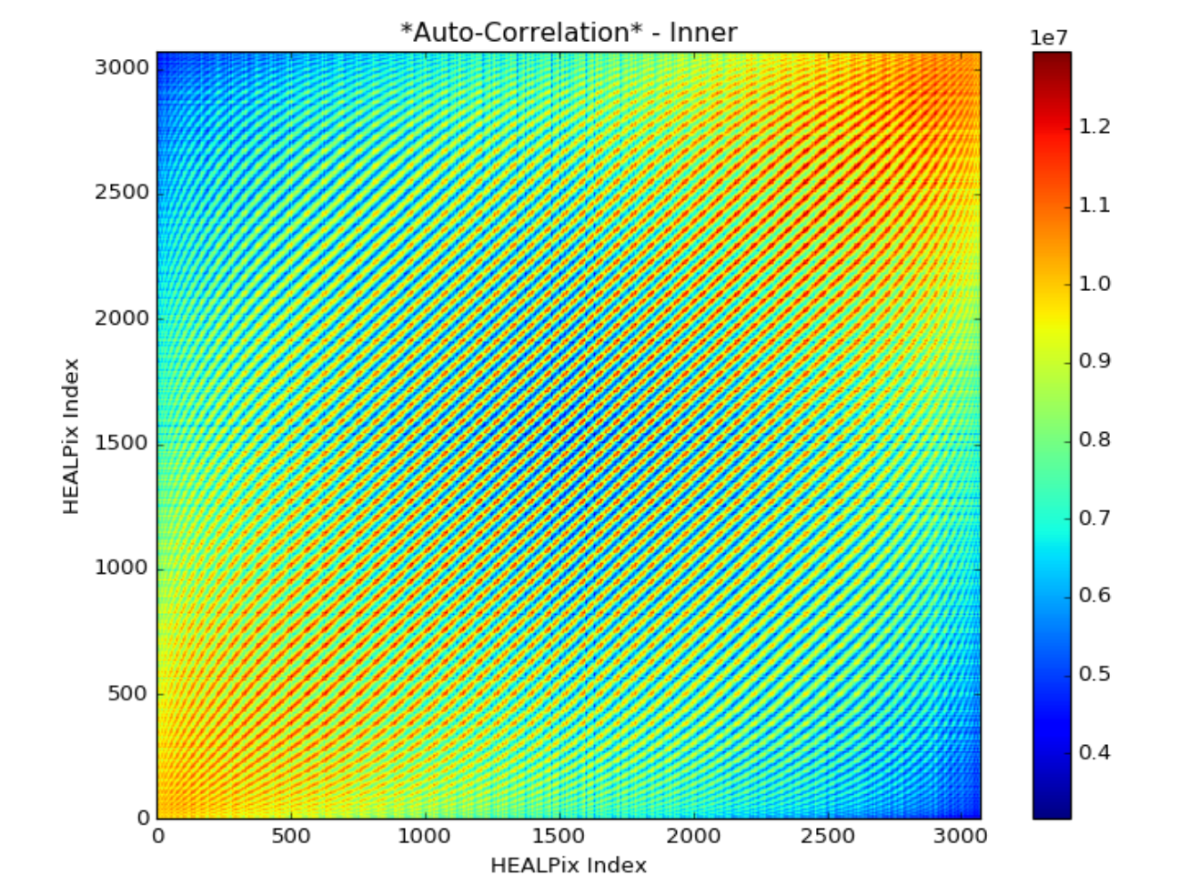

DOI
Outer (titles are wrong)
Inner (titles are wrong)

Slide 17


DOI – Inner and Outer
MLEM reconstruction, outer
MLEM reconstruction, inner

Slide 18


DOI – Inner and Outer
Outer
Inner

Slide 19




OUTER
HP = 1568
HP - 2068

Slide 20




INNER
HP – 1568
HP = 2068

Slide 21


Sensitivity correct the autocorrelation (inner and outer)
Inner
Outer

Slide 22






HP = 1070
HP = 2022
No doi
outer
inner

